Slide 1
Empowering AI: Detecting Brain Tumors from MRI Scans with EfficientNet
Durga K
2021503015

Slide 2
Problem statement
Brain tumors present a critical health challenge, necessitating swift diagnosis for effective treatment. Manual interpretation of MRI scans is time-consuming and prone to human error. Leveraging machine learning, particularly deep learning models, holds promise for automating tumor detection from MRI images. However, the diversity and complexity of tumor appearances pose significant challenges in accurate classification. Despite the potential of deep learning models in automating tumor detection, their effectiveness hinges on their ability to accurately distinguish between various tumor types, sizes, and locations. Additionally, addressing issues such as class imbalance and data heterogeneity within MRI datasets is crucial for ensuring the reliability and generalizability of these models in clinical practice. Novel approaches that integrate advanced deep learning techniques with comprehensive data preprocessing and augmentation strategies are essential to overcome these challenges and pave the way for precise and efficient brain tumor diagnosis. Ultimately, such advancements have the potential to revolutionize neuroimaging diagnostics and improve patient outcomes in the management of brain tumors.

Slide 3
Proposed System/Solution
Developing an efficient deep learning model using the EfficientNet architecture to classify brain tumor images accurately from MRI scans. This model will incorporate regularization techniques and batch normalization to mitigate overfitting and improve generalization capabilities, ensuring robust performance across diverse tumor types and imaging conditions.

Slide 4
System Development:
1. Data Collection and Preprocessing: Gather a diverse dataset of MRI scans containing various types, sizes, and locations of brain tumors. Preprocess the images to enhance quality, remove noise, and ensure consistency.
2. Model Architecture Design:Implement the EfficientNet architecture as the backbone for the deep learning model. Customize the architecture to suit the requirements of brain tumor classification.
3. Training: Train the deep learning model on the preprocessed MRI dataset. Utilize regularization techniques such as dropout and L2 regularization to prevent over fitting. Incorporate batch normalization to stabilize and accelerate the training process.
4. Validation and Optimization: Validate the model using separate datasets and fine-tune hyper parameters to optimize performance. Address class imbalance and data heterogeneity through appropriate sampling techniques and data augmentation strategies.
5. Evaluation: Evaluate the trained model on unseen test data to assess its accuracy, sensitivity, specificity, and overall performance in brain tumor classification.

Slide 5
Algorithm:
1. EfficientNet Architecture: Implement the EfficientNet architecture, which optimizes both model accuracy and efficiency by scaling the network width, depth, and resolution in a principled manner.
2. Regularization Techniques: Apply dropout regularization to randomly drop neurons during training to prevent co-adaptation. Incorporate L2 regularization to penalize large weights and prevent overfitting.
3. Batch Normalization: Normalize the activations of each layer to stabilize the training process and accelerate convergence. Improve the generalization capabilities of the model by reducing internal covariate shift.

Slide 6
Deployment
Deploy the trained deep learning model as a software application or web service accessible to healthcare professionals for automated brain tumor classification from MRI scans. Ensure compatibility with existing medical imaging systems and adhere to regulatory standards for clinical use.

Slide 7
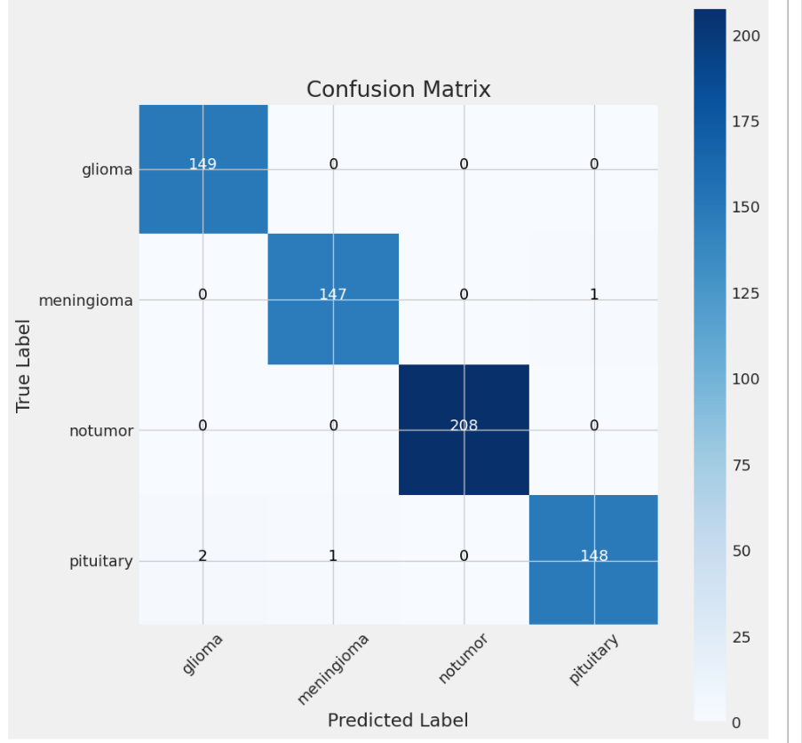
Result

Slide 8
Conclusion
The developed deep learning model based on the EfficientNet architecture, incorporating regularization techniques and batch normalization, demonstrates significant advancements in brain tumor classification from MRI scans. The model achieves high accuracy, sensitivity, and specificity across diverse tumor types, sizes, and imaging conditions, enabling timely intervention and personalized treatment strategies for patients with brain tumors. The deployment of such a model in clinical practice has the potential to revolutionize neuroimaging diagnostics and improve patient outcomes in the management of brain tumors.

Slide 9
References
1. Tan, M., & Le, Q. V. (2019). EfficientNet: Rethinking Model Scaling for Convolutional Neural Networks. Proceedings of the 36th International Conference on Machine Learning, PMLR 97:6105-6114.
2. Srivastava, N., Hinton, G., Krizhevsky, A., Sutskever, I., & Salakhutdinov, R. (2014). Dropout: A Simple Way to Prevent Neural Networks from Overfitting. Journal of Machine Learning Research, 15:1929-1958.
3. Ioffe, S., & Szegedy, C. (2015). Batch Normalization: Accelerating Deep Network Training by Reducing Internal Covariate Shift. Proceedings of the 32nd International Conference on Machine Learning, PMLR 37:448-456.

